Slide 1


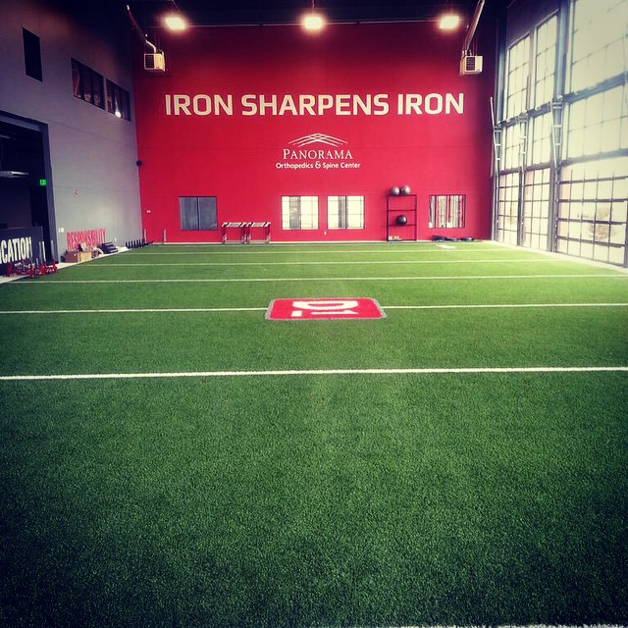
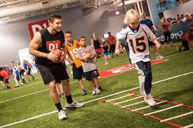
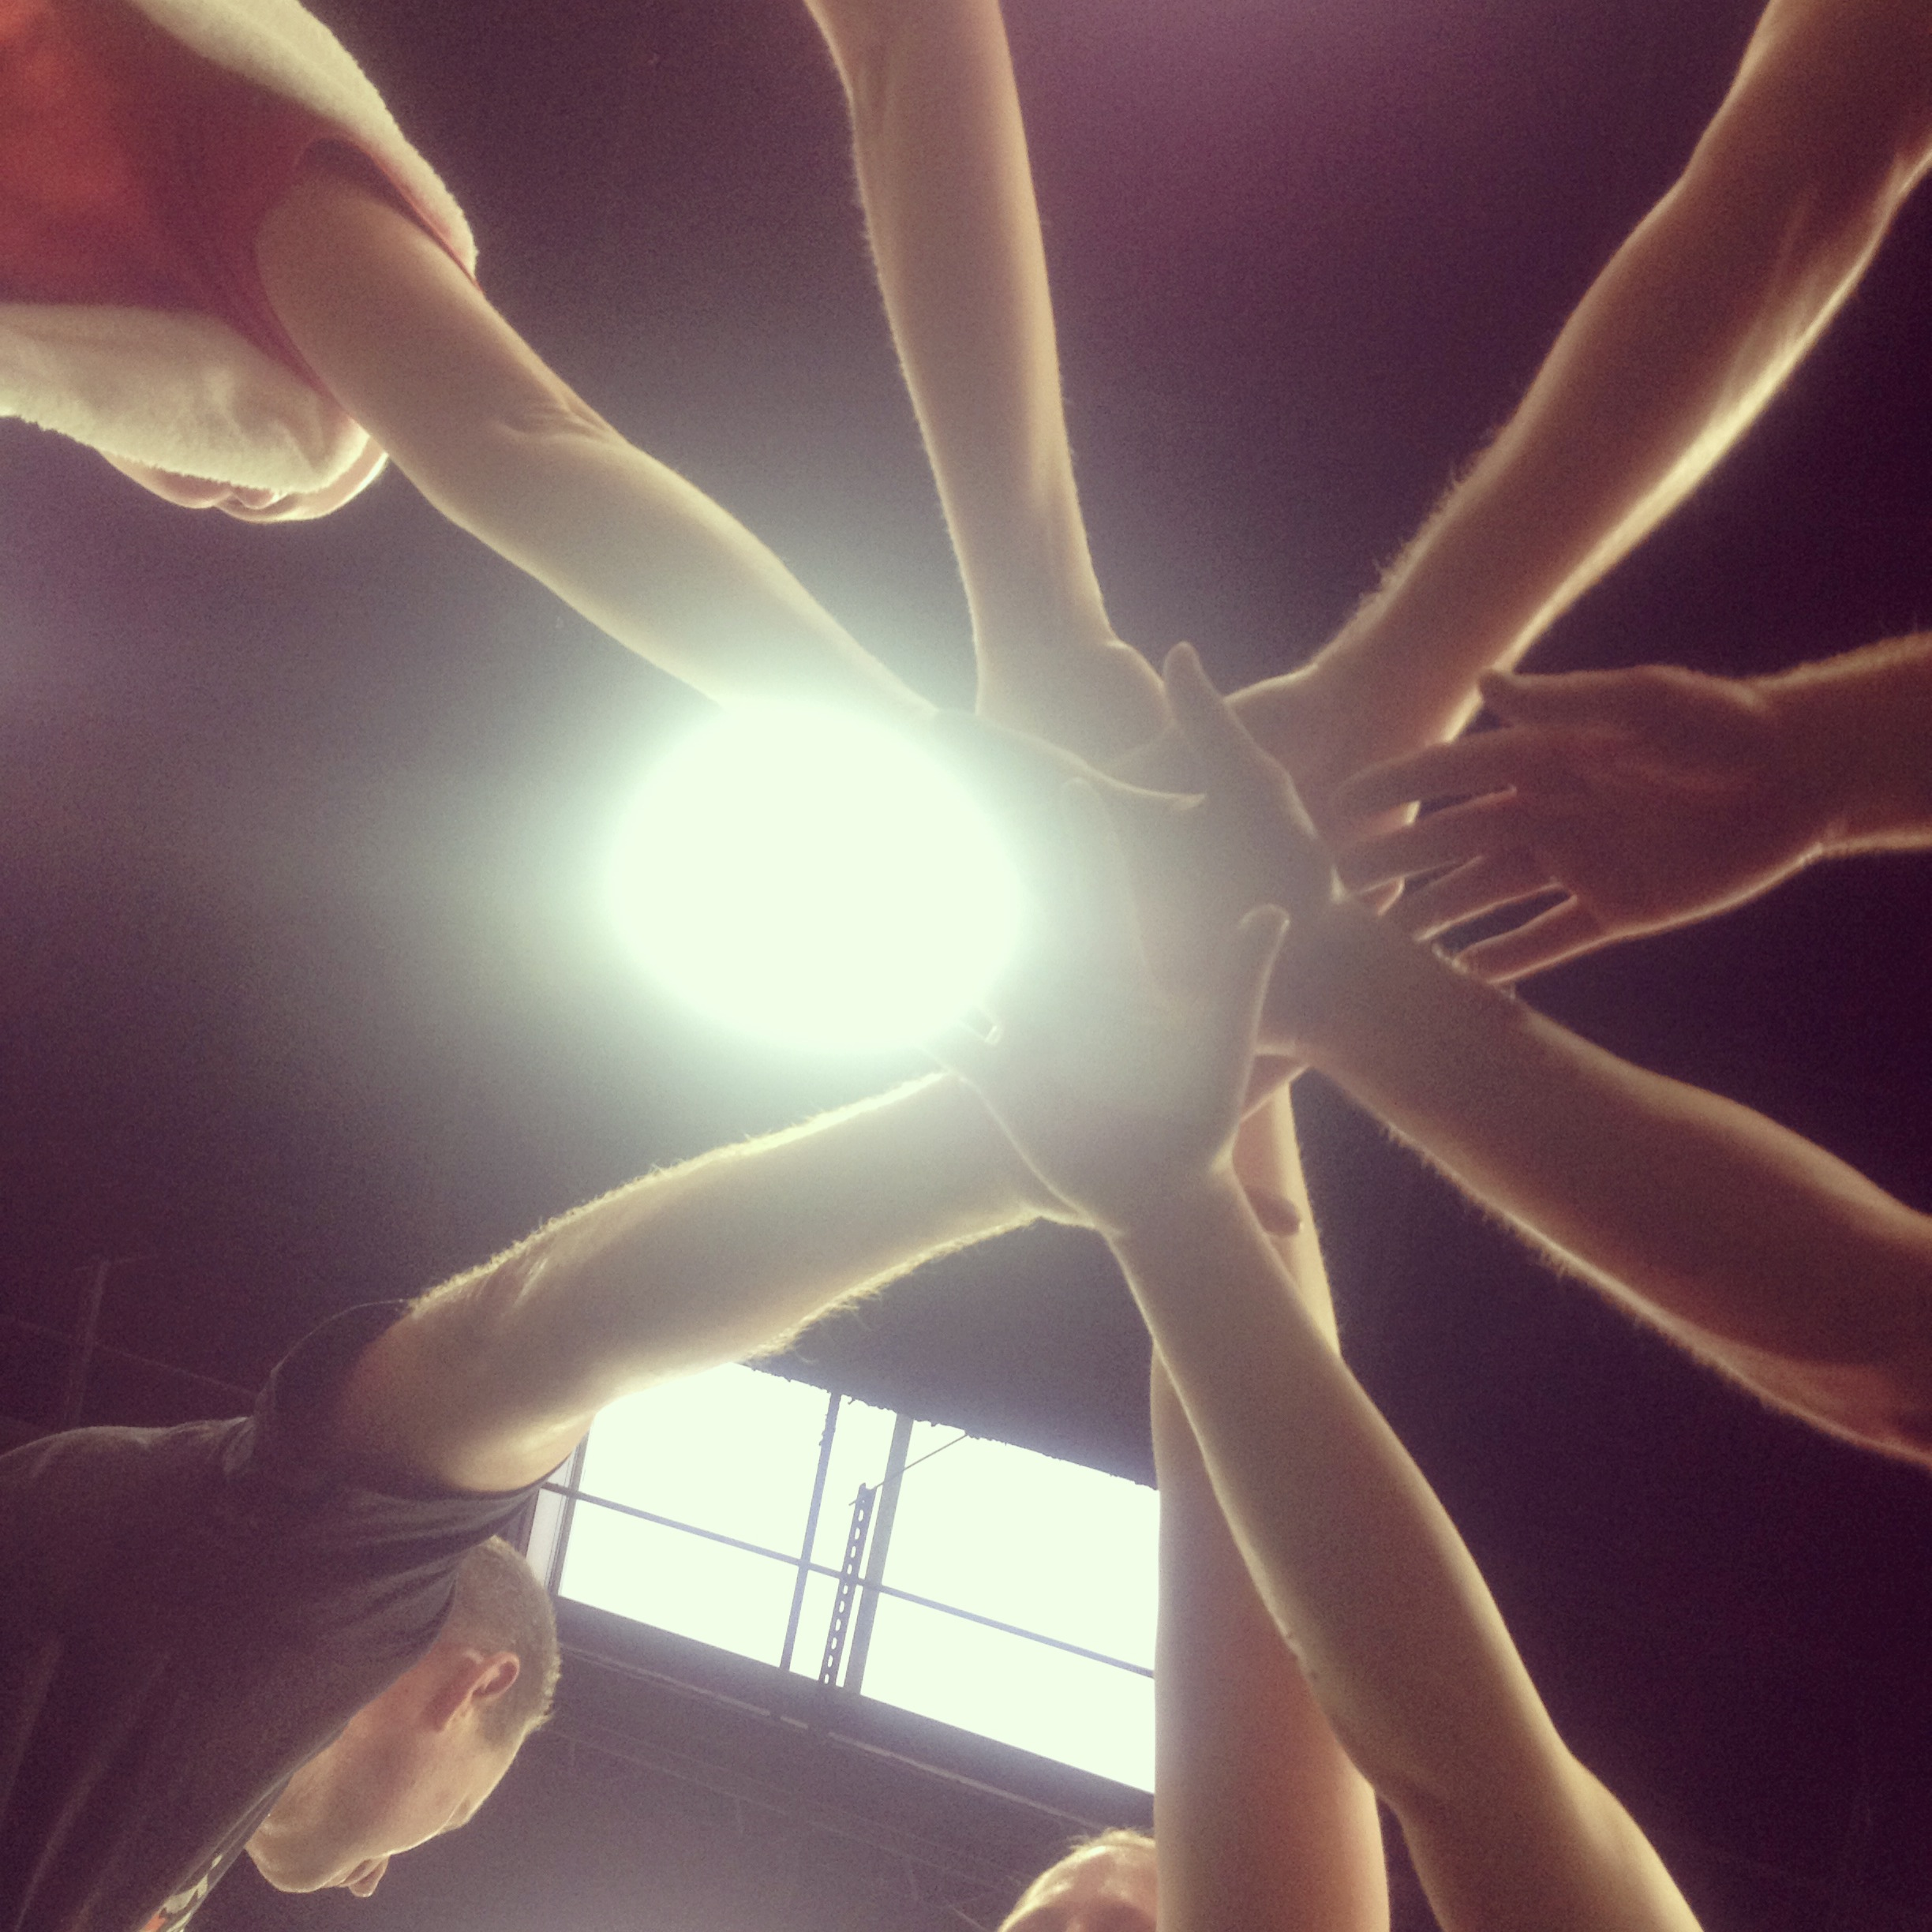
CHRIS KUPER MKMNSPEED & AGILITY/ATHLETIC DEVELOPMENT SUMMER CAMP
D1 develops speed, agility, and explosive power in an encouraging, fun, and competitive atmosphere. Helping athletes develop proper running and jumping mechanics, along with footwork, reaction time, and explosiveness. We will bring out the athlete within!
D1 is The Place for the Athlete!
DATES: August 9th & August 16th
AGES: 6- 10yrs on Aug 9th & 11- 14yrs on Aug 16th
TIME: 1-230pm
Price: $25
Additional to speed and agility we will include character development, nutrition, and work on self-confidence!
Space is limited!!!
To Sign up or for more information:
Call or Email: 720.214.7082
ronnie.degray@d1sportstraining.com
Or visit www.d1denver.com
D1 Denver
1060 Plaza Dr Suite 100
Denver, CO 80126

